Slide 1

Tensorflow Workshop
by Vitali Kaiser and Fabian Both

Slide 2
Agenda
Session I (15:00 – 16:15)
Why Tensorflow?
Installation
Run Example Code
What is a MLP?
Tensorflow Basics
Computation Graph
The Session

Slide 3
Agenda
Session II (16:45 – 18:00)
Step by step explanation
Change code
Use Tensorflow API
Experiments with parameters
What is good, what is bad?

Slide 4
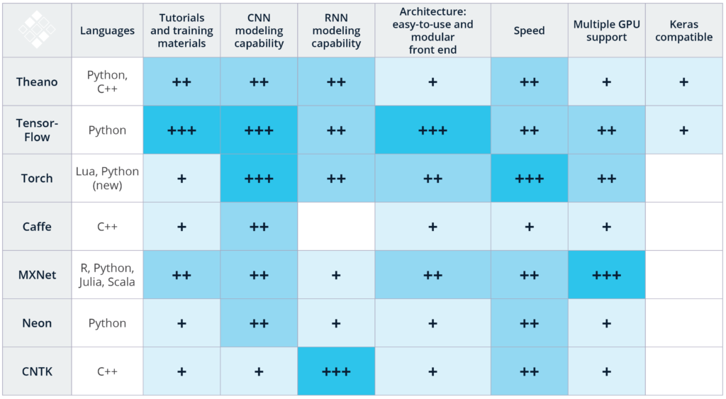
Why Tensorflow?
Source: http://www.kdnuggets.com/2017/03/getting-started-deep-learning.html
Notes:
Large Community
Company effort (Google and others)
Largest number of github stars and contributors (2-3 times larger then next)
Easy access in python

Slide 5
Installation
Install VirtualBox
Download virtual machine template
https://goo.gl/UEAeBi
Root password: understandai

Slide 6
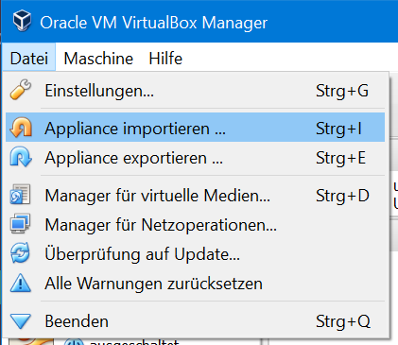
Installation
Start VirtualBox
Import Appliance

Slide 7
Run Example Code
Open Pycharm
Run the code

Slide 8
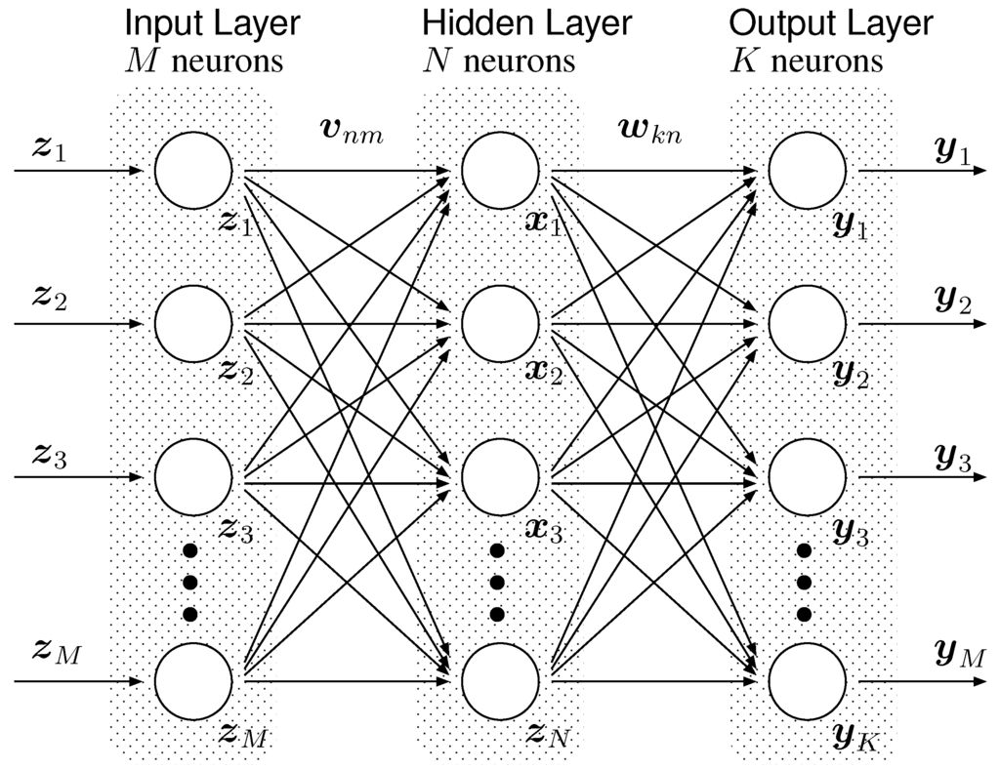

What is a MLP?
Input (Pixels)
1 ?
2 ?
3 ?
9 ?
Source: http://www.mdpi.com/2078-2489/3/4/756/htm
Notes:
MLP = Multi-Layer Perceptron

Slide 9
Tensorflow Basics Computation Graph
The Tensorflow Graph is used as node representation for your computations
Only necessary elements for a specific operation are computed
It is used for Gradient Propagation
If not specified, the default graph is used

Slide 10
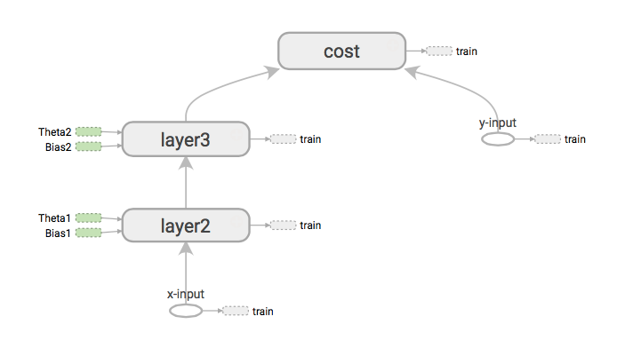
Tensorflow Basics Computation Graph
Source: https://aimatters.wordpress.com/2016/01/16/solving-xor-with-a-neural-network-in-tensorflow/

Slide 11
Tensorflow Basics Computation Graph
No two tensors with the same name can exist
Name Scopes can be utilized to aggregate variables
Variables in the Graph need to be initialized
The memory for data batches is allocated at runtime

Slide 12
Tensorflow Basics The Session
In a session, graph variables are initialized
Separate sessions (and graphs) can exist
Sessions are used to execute operations
Session.run([operations], feed_dict, …)
Data can be feed through the feed_dict
Notes:
Initialization: tf.global_variables_initializer().run() [Line 300, this is a shortcut]
Feed_Dict: 252-253

Slide 13
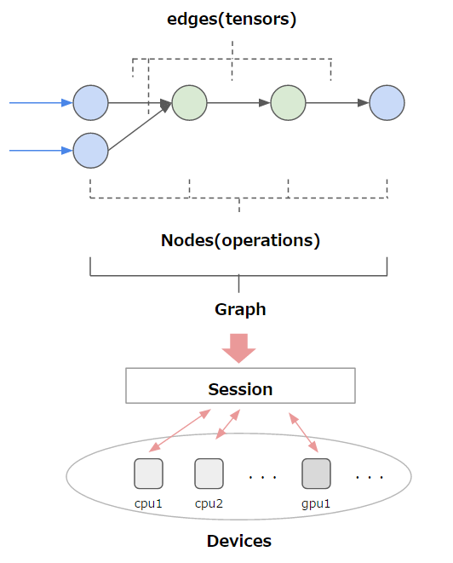
Tensorflow Basics The Session
Source: https://leonardoaraujosantos.gitbooks.io/artificial-inteligence/content/tensorflow.html

Slide 14
Tensorflow Basics The Session
Source: https://leonardoaraujosantos.gitbooks.io/artificial-inteligence/content/tensorflow.html
Notes:
Tensorflow in action. The computation graph is computed, gradients are propagated

Slide 15
Explore Tensorboard
Logfiles of a Run are Stored
Invoke Tensorboard tensorboard --logdir=/path/log/folder --port 6006

Slide 16
Agenda
Session II (16:45 – 18:00)
Step by step explanation
Change code
Use Tensorflow API
Experiments with parameters
What is good, what is bad?

Slide 17
Step by step explanation
Data Iterator
Graph Construction
Model Inputs
Loss Function
Summaries
Training Loop

Slide 18
Change Code
Use Tensorflow API
Exchange the optimizer (AdamOptimizer)
Adjust learning rate during training
After 500 steps, divide learning rate by 10
Notes:
https://www.tensorflow.org/api_docs/python/tf/train/RMSPropOptimizer

Slide 19
Experiments with parameters
Get the best performance!
Change Network Architecture
Change Training Rate
Change dropout
…

